Slide 1


lecture one: Introduction to BASIC HTML
Basic syntax, tags, attribute, forms

Slide 2

content
Html basics: syntax (guideline or rules to write html), elements ( used to create a web page
Html form: How you can create a form for a user
Html media: adding video or audio file to a web page

Slide 3
objectives
Design a simple web using basic syntax, tags, attributes etc. Link a page to another
Create form

Slide 4
WHY HTML?
Web development (task involved in designing a web application) – simple or complex
To get started, you are advised to learn HTML, CSS and Javascript (at least)
Without HTML, no content on your web
A markup language that uses Tag to define to define a specific type of content on a web page e.g <p> </p>
HTML stands for Hypertext Markup Language, and it is the most widely used language to write Web Pages.

Slide 5
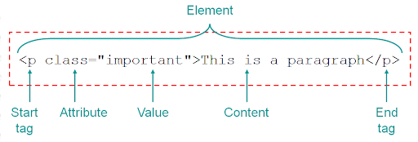
Html basic syntax
The rule required to write html code

Slide 6
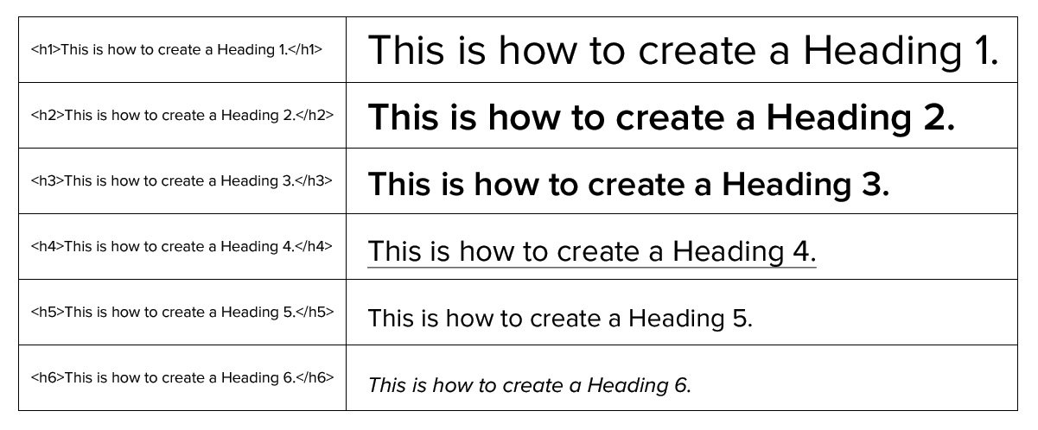
Example of Html tags Heading tags

Slide 7

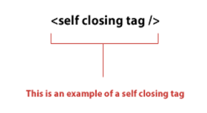
Example of Html tags self closing tags

Slide 8
CREATE A FIRST HTML PAGE
MAC USER: text editor
Windows: notepad
It is a plain text file (no deep coding)
Very easy to learn when you know basic synthax.

Slide 9
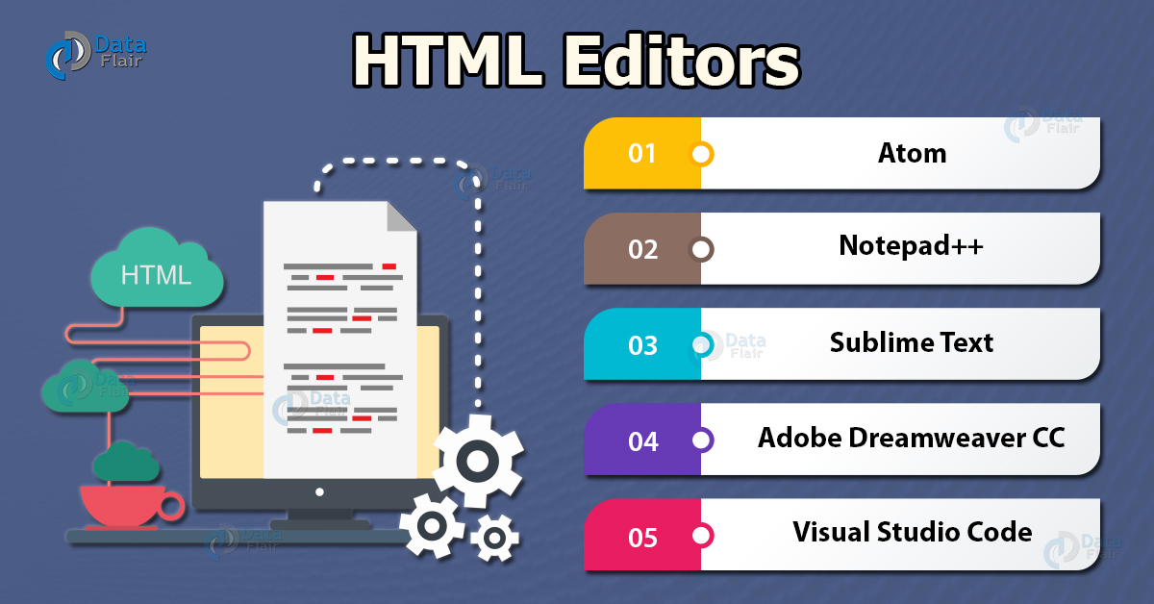
Html editors installation
They make coding easier and faster
Examples include Sublime text (recommended), brackets, visual studio code etc

Slide 10
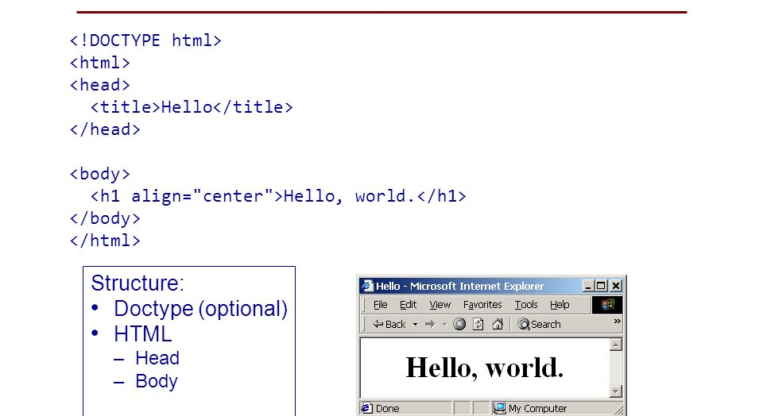
Html page structure

Slide 11
Html page structure: head elements
It is the invisible part of the html. It gives additional details of html

Slide 12
Body tag
Contains all the visible contents of a page e.g. heading , paragraph, anchor etc.
<h1>this is heading 1</h1>
<h2>this is heading 2</h2>
<p>this is heading 2</p>
<a href=“”> click </a>

Slide 13
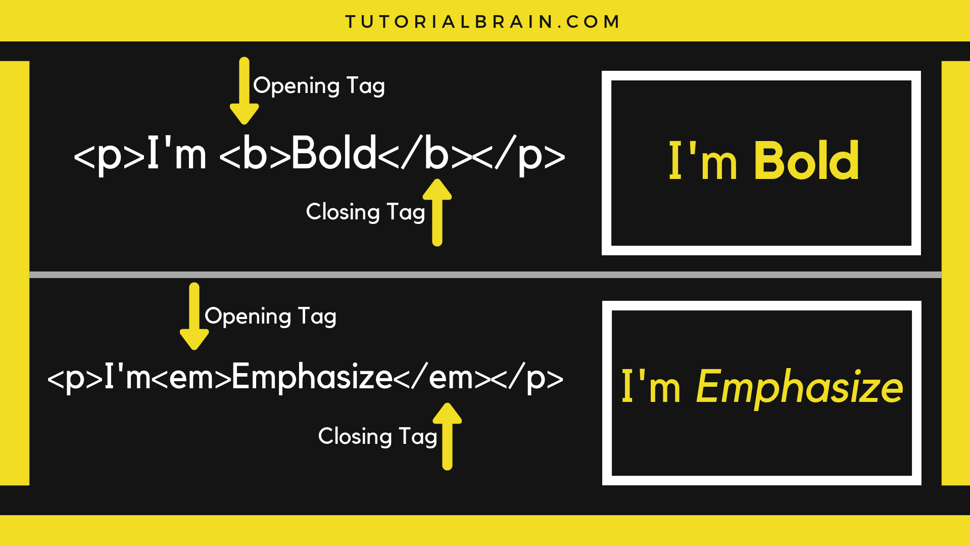
Html nested element

Slide 14
ATTRIBUTES
Used to modifyan elements
Must be defined after the opening tag
Examples: src, HREF, ID, WIDTH & HEIGHT, STYLE

Slide 15
HTML COMMENTS
WRITTEN NOTE THAT EXPLAIN OR DISLAY SOMETHING
DEBUG ERRORS
READABLE BY OTHERS
SETTING REMINDER
<!-- COMMENT -->

Slide 16

HTML CSS
CSS (cascading styles sheet) defines appearance of our web page
CSS can be added to html in three ways (inline, internal, external)
INLINE: USING STYLE ATTRIBUTE IN HTML ELEMENTS
INTERNAL: USING HTML SYLE TAG
EXTERNAL: BY ADDING SEPARATE CSS FILE

Slide 17
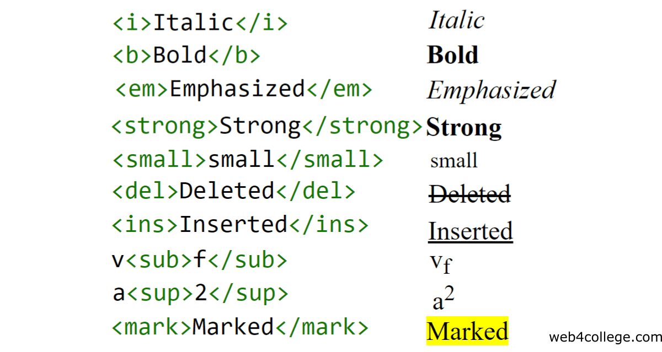
HTML FORMATTING
Special html that we use to define special meaning e.g bold, italics, subscript, superscript

